Slide 1

26-27
ISOK Clubs

Slide 2


Slide 3


Slide 4


Slide 5
PROM COMMITTEE
Help us plan this year’s PROM (decor, songs, etc.)
Last Wednesday of the month at 3:00
Students who attend all meetings and help with Prom Setup will get in for free
Interested? Sign Up Here - https://docs.google.com/forms/d/e/1FAIpQLSeGVRJroeMis_VrXb_WJLS8fmdoLY7xObwDb4nAiDQT4YFGQw/viewform?usp=header

Slide 6


Teachers: Mrs. DiMaggio and Mrs. Noakes
Click here to join Foreign Language Club:
Foreign Language Club – Fill out form

Slide 7
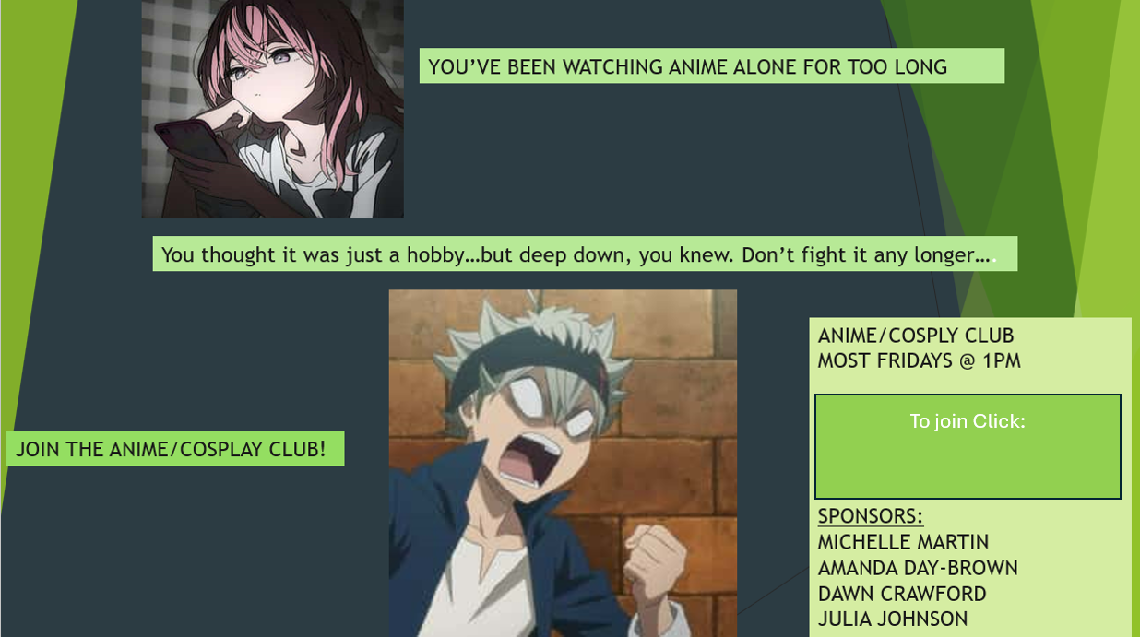
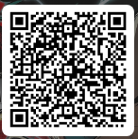
https://tinyurl.com/3u2n6328
To join scan
The QR Code

Slide 8
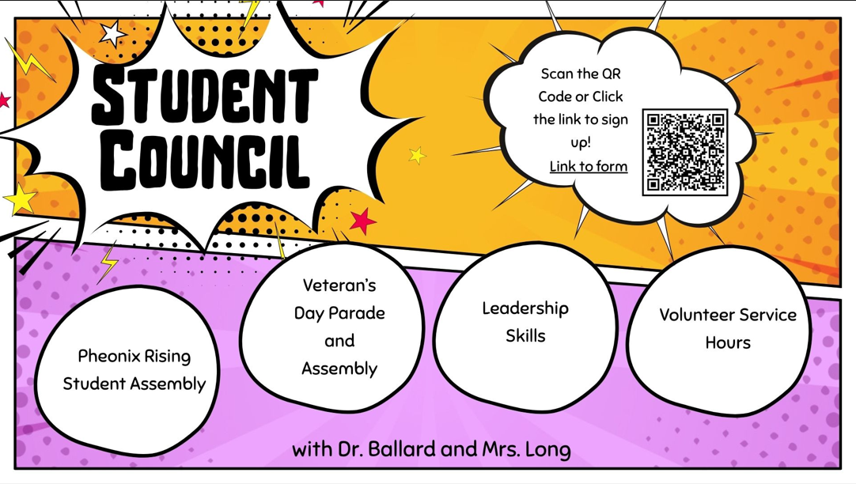

Slide 9

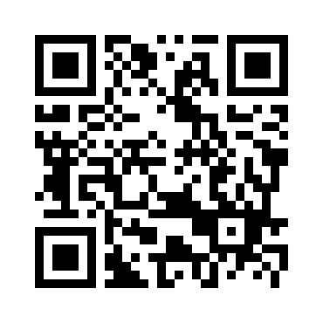
Science Club 26/27 – Fill out form

Slide 10

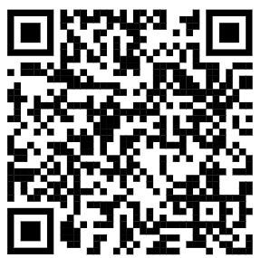
Click here to sign up:
Student Club Sign-Up Form - Auto Club 26-27 – Fill out form

Slide 11


Slide 12

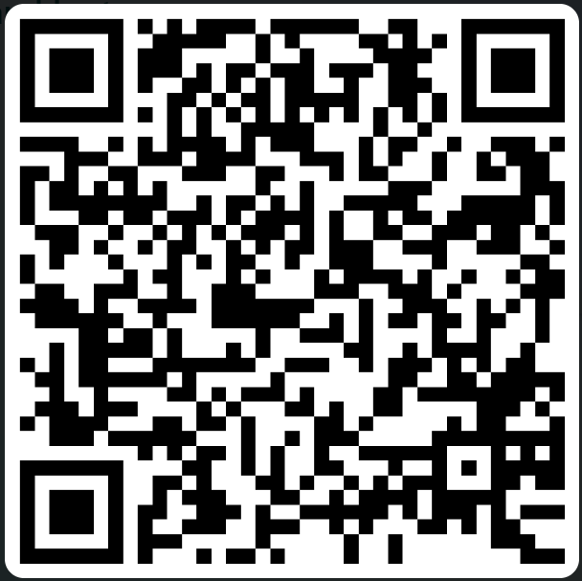
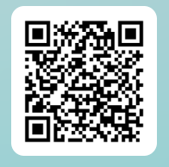
Art History and Art Appreciation Club
Art and Art History Club
With Mrs. Huerta, Mrs. Orler, Mrs. Butler and Mrs. Al Hakiem
Meeting- 3 pm Every other Wednesday
Sign-up
https://forms.cloud.microsoft/r/9mMaFAxRT0?origin=lprLink

Slide 13

Scan here to sign up!
https://bit.ly/4mBvzyk

Slide 14


Slide 15



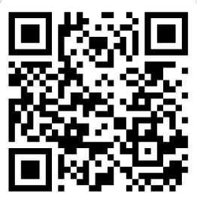
Act, Write, Direct, Create!
Make Props and Costumes
Read Poetry
Sign up here:
https://forms.gle/GFcS4cQQKaeMnJ6n6
Learn Film
Do Comedy
Drama Club Sign Up
First Tuesday of every month at 3:15 p.m.

Slide 16

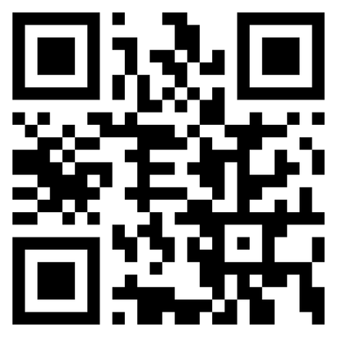
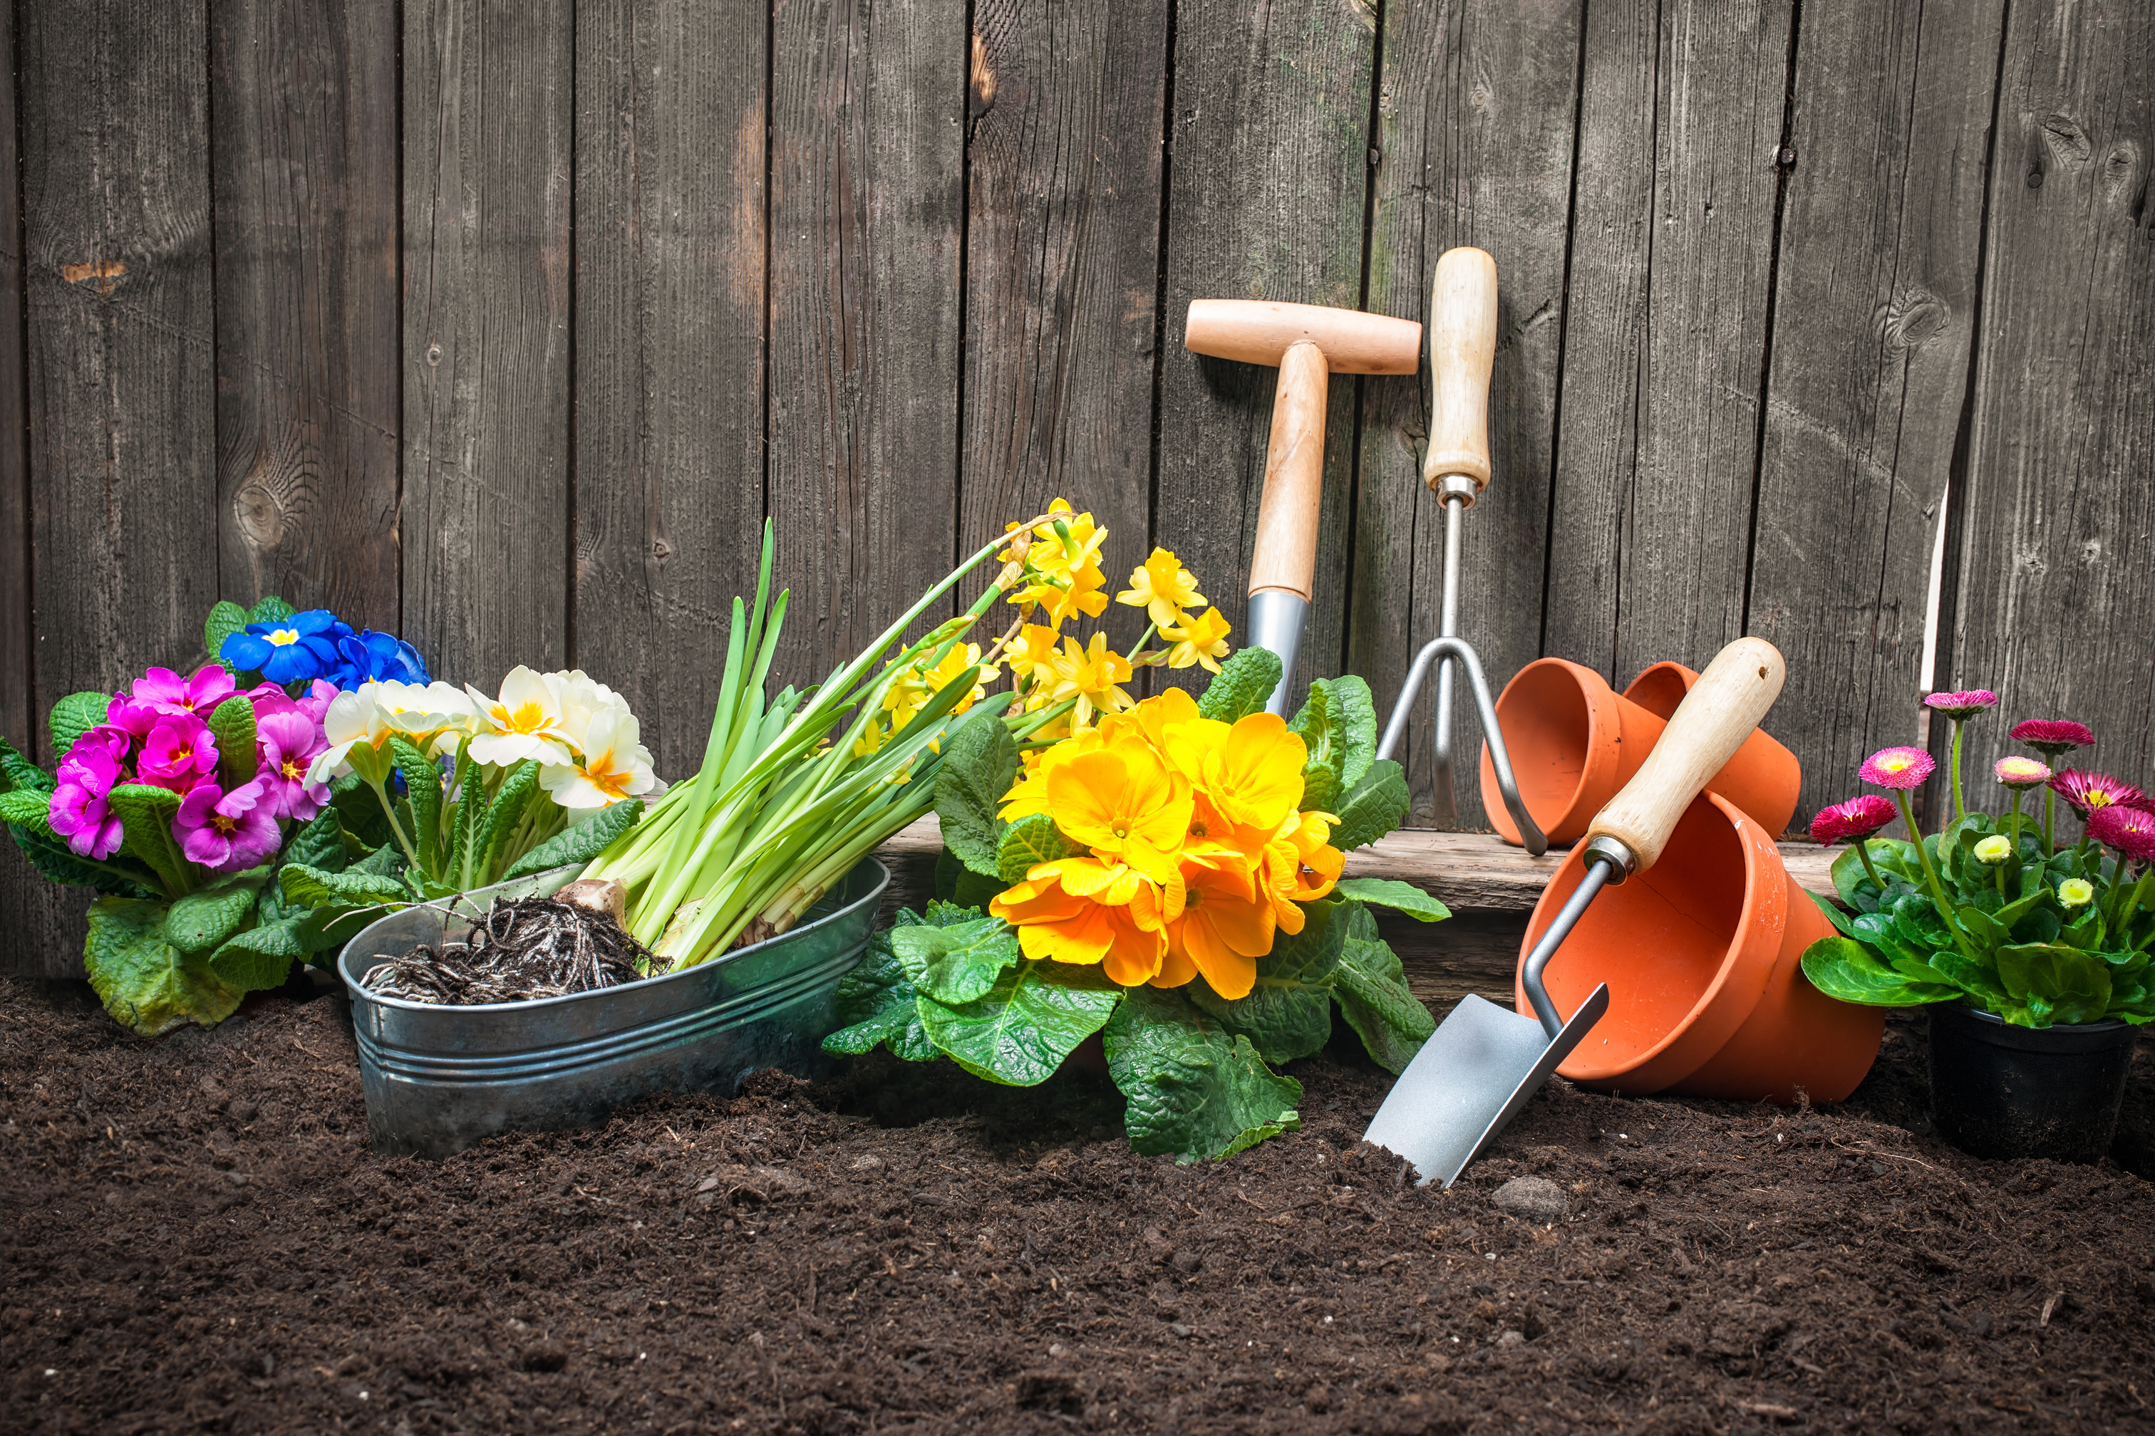
Join the
GARDENING CLUB
With Mrs. Binkley & Ms. Hudson
Ready to Grow?
Scan to Sign-Up!
Plant Something New
Connect with Fellow Students
Share your Garden Journey
Learn & Grow Together
GARDENING CLUB SIGN-UP LINK
First Meeting
Coming Soon!
Where
Online
(Link will be provided)
Questions?
Contact Club Sponsor for more info.

Slide 17

Click Here to Sign Up for Social Club!

Slide 18

Click Here to Join Book Club by Filling Out This Survey
First Meeting: August 27, 2026 @ 4:00-4:30pm
Sponsors:
Mrs. Cotton (math), Ms. Keller (ELA), Mrs. Penuel (ELA), & Ms. Woods (ELA)
Questions & Help: Contact Ms. Woods at awoods@insightok.org

Slide 19
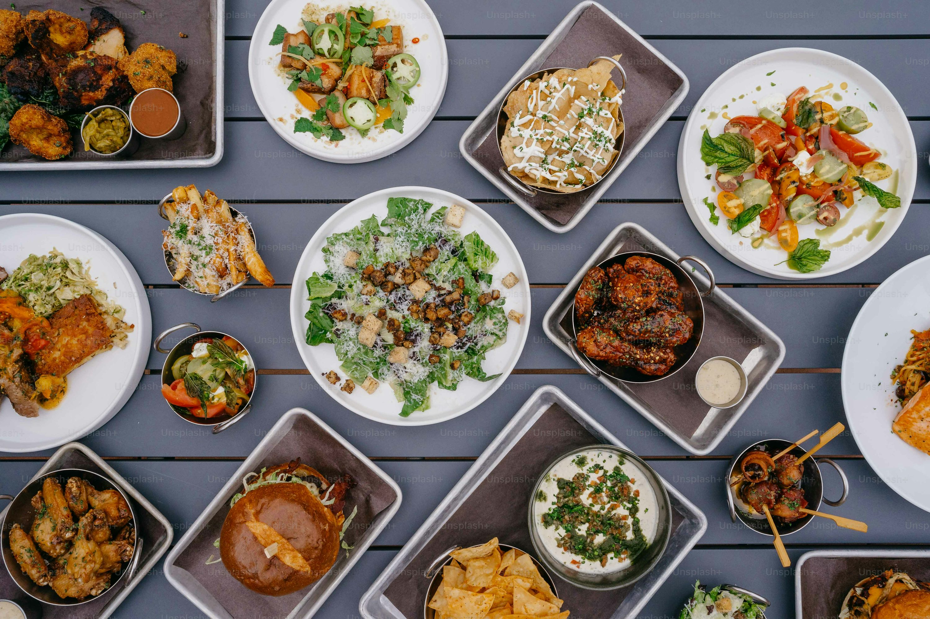

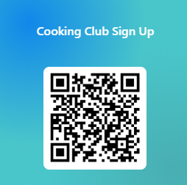


Do you like food?
Do you love cooking or baking?
Do you enjoy the company of Mrs. Stone and/or Mr. Popham?
Join cooking club where you might learn:
New recipes
Cooking tips / tricks
Budget friendly meals
Food around the world
Meal planning
We will meet on the first Thursday of each month at 3:00pm
The first meeting will be on 9/3
Use the following link to sign up: https://forms.cloud.microsoft/r/PeJhNUKSGD

Slide 20




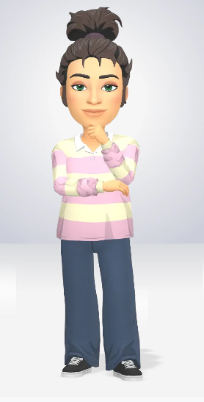
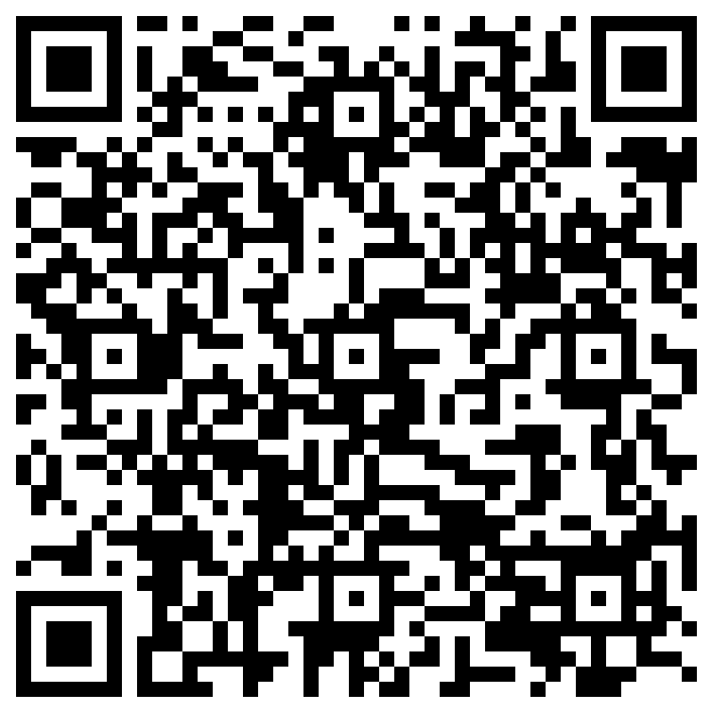
Club
Music Club sign up – Fill out form
We meet the last Tuesday of every Month @ 3pm!
"Our Music Club envisions a vibrant community where students ignite their passion for music through collaboration, creativity, and exploration. We aim to foster a supportive environment that encourages musical growth and appreciation, empowering every member to share their unique talents and connect with others. Together, we aspire to harmonize our diverse voices and cultivate a lifelong love for music that transcends the virtual space.

